Slide 1
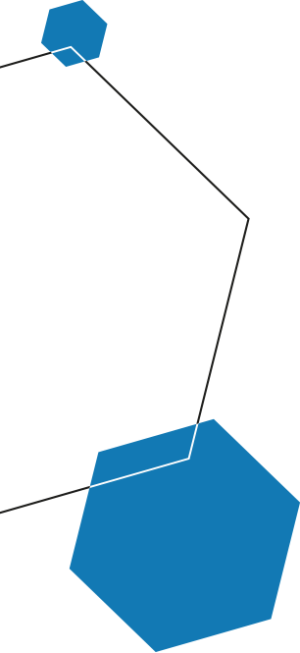

Core Kubernetes training
Octobre 2020

Slide 2
On the agenda
1
From monolith to microservices
2
Docker reminders
3
Why is Kubernetes successful?
4
Kubernetes core objects
5
Kubernetes architecture
6
Carrefour use case – hands on
Notes:
SGE

Slide 3
From monolith to microservices

Slide 4
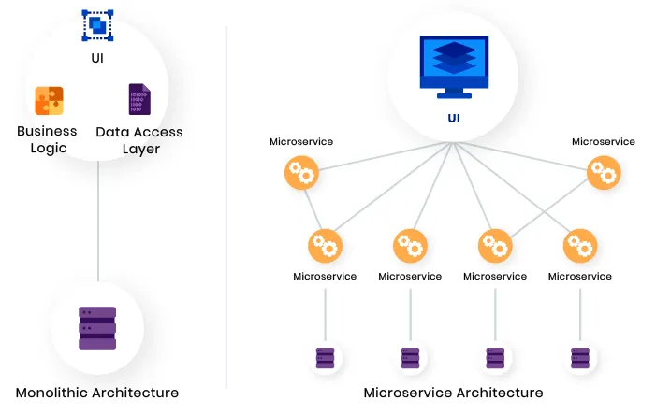

Monolith vs microservices architecture
Monolithic applications ( traditional enterprise architecture or software patterns )
Raises several issues:
sedimented layers of features and redundant logic translated into thousands of lines of code
every new feature added more complexity and code was building up continuously
application tightly coupled with its complex and expensive hardware
hardcoded connections and operations
Running as a single process and on a single server which has to satisfy its compute, memory, storage, and networking requirements
maintenance windows have to be planned as disruptions in service are expected to impact clients
hard for developers to work in parallel since each components is tightly coupled with the rest of the applications
Microservices ( break down the monolith app into smaller independent blocks, called "services")
Main purposes:
Single purpose: one single purpose per service
Loose coupling: services know little about each other. A change to one service should not require changing the others. Communication between services should happen only through public service interfaces.
High cohesion: each service encapsulates all related behaviors and data together. If we need to build a new feature, all the changes should be localized to just one single service.
Lucy
2003
Now

Slide 5
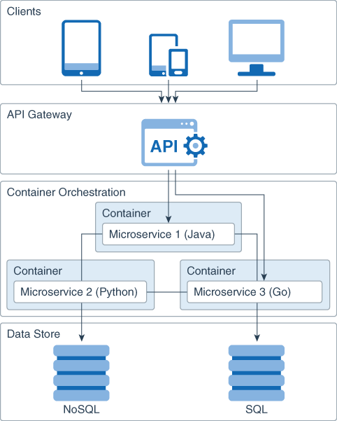
Containerized applications
Virtualizations and containerization played a major role in the microservices revolution
Containerized Microservices are lightweight applications written in various modern programming languages, with specific dependencies, libraries and environmental requirements.
Ensuring that the applications can run correctly by packaging them with its dependencies. Containers encapsulate microservices and their dependencies but do not run them directly. Indeed, Containers run container images.
Container image: bundles the application along with its runtime and dependencies, and a container is deployed from the container image offering an isolated executable environment for the application.
In addition to all these advantages, containerized micro-services offer
Decoupling with other services
Decoupling with hardware/system:
as long as a container runtime is installed, you can run your container image on any host os
containerized MS developped on local machine can be deployed on dev/prod servers without any modification
Lucy
2003
Now

Slide 6
Docker reminders

Slide 7
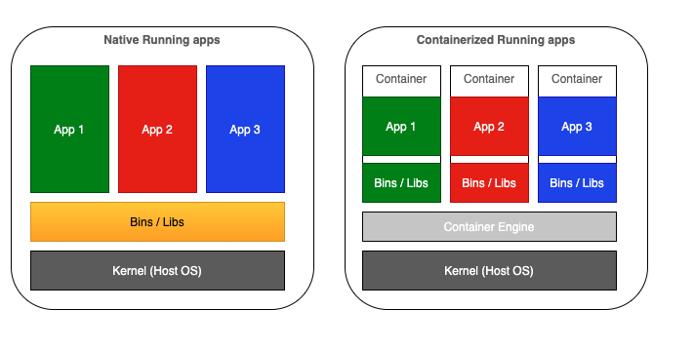
Native Running vs Containerized Applications
Lucy
2003
Now
Isolation

Slide 8
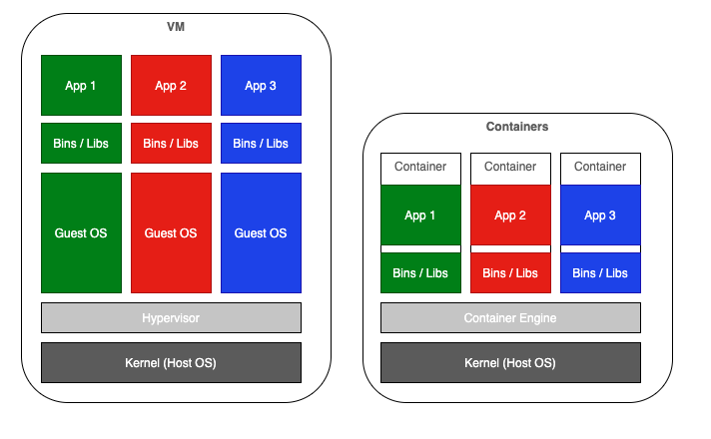
Virtualization vs Containerization
Lucy
2003
Now
Lightweight
Portable

Slide 9
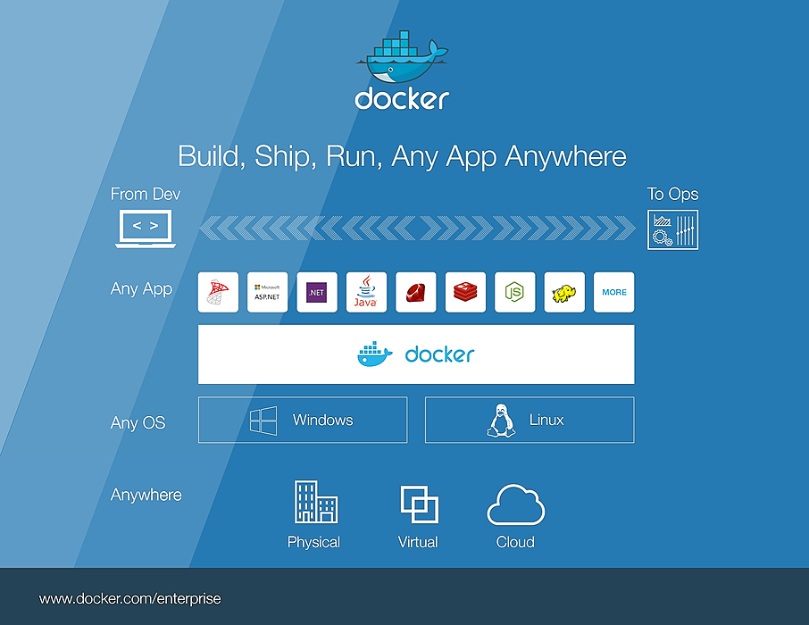
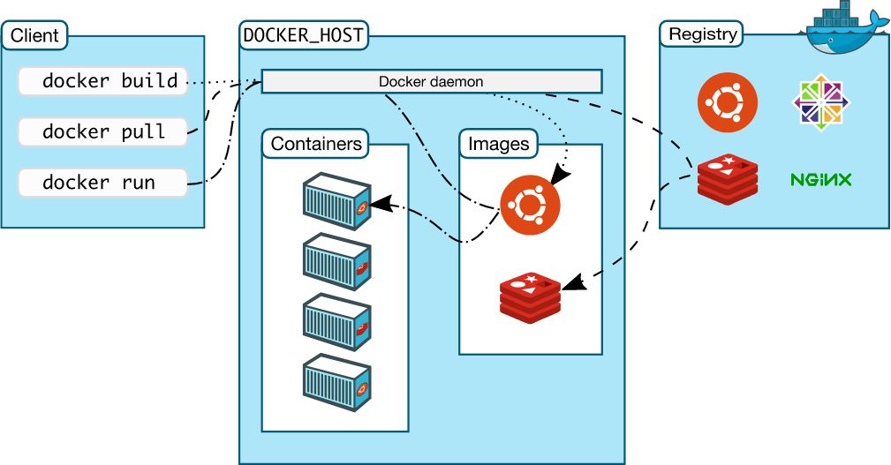
Docker in a nutshell
Lucy
2003
Now
Docker Daemon responsible for
Building
Running
Distributing
Docker Images

Slide 10
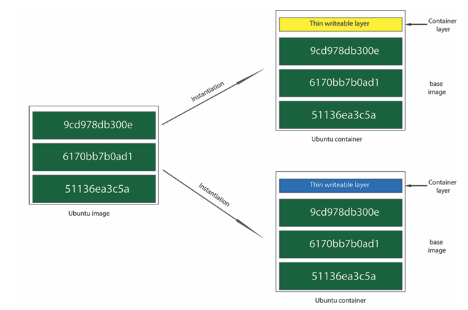
Docker images & Docker containers
Docker Containers are immutable.
Changes in container layer are are tied to container lifecycle, unless commit explicitly.

Slide 11
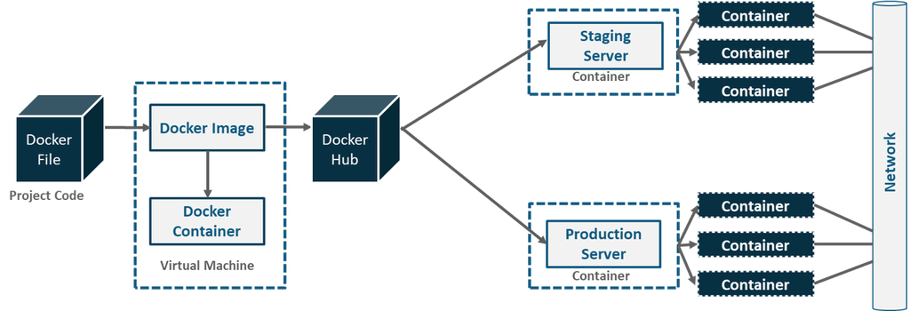
Docker for production
Lucy
2003
Now

Slide 12

Docker limitations
Imagine now that you are a data engineer for a Big Enterprise that run thousands applications on docker. That companies have several different servers to deal with a high number of requests and ensure high availability in case of some servers' crash.
Here some points feasible with Docker but that you might struggle with:
How to deploy your docker container to multiple servers ?
What will you do if an application crash on a container?
Imagine you want to make a small change an app. How do you do it while ensuring high-availability ?
The number of requests increase how do you scale up your applications ?
Imagine that containers are communicating with each other, to which container should it talk with and what happen if that container crash ?
How do you handle volumes with docker ?
Basically, how do you deploy Docker apps in productions ?
Lucy
2003
Now

Slide 13
Why is Kubernetes successful?

Slide 14
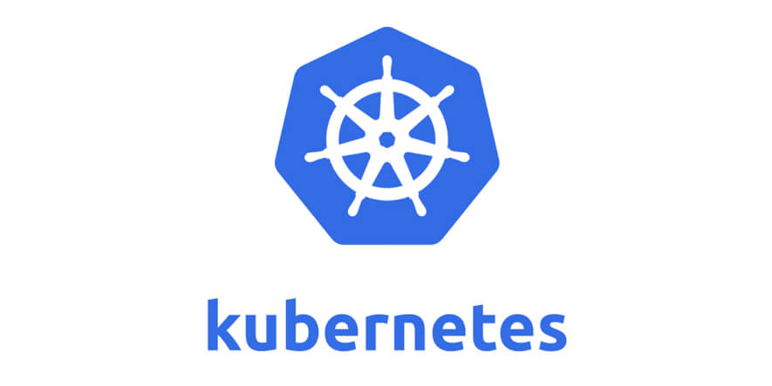
Kubernetes
Lucy
2003
Now
''' Kubernetes is a portable, extensible, open-source platform for managing containerized workloads and services, that facilitates both declarative configuration and automation. It has a large, rapidly growing ecosystem. Kubernetes services, support, and tools are widely available. '''

Slide 15
Kubernetes: a containers' orchestrator
Container orchestrators
Although we can manually maintain a couple of containers or write scripts for dozens of containers, orchestrators make things much easier for operators especially when it comes to managing hundreds and thousands of containers running on a global infrastructure.
Containers orchestrators are tools which:
brings together individual machines into a cluster using a shared network to communicate between each server
where containers' deployment and management is automated at scale
offer fault-tolerance
on-demand scalability
Kubernetes success factor
Main characteristics:
scalability
isolations
flexibility
Resilience
Reduced complexity (less hardware, storage, networking issues)
k8s is also particularly powerful dealing with:
seamless rollout and rollbacks
scalabity (auto-scalability): scaling manually or automatically based on CPU or custom metrics utilization
self-healing : automatically replaces and reschedules containers from failed nodes
service discovery and load balancing
Lucy
2003
Now

Slide 16
Kubernetes core objects

Slide 17
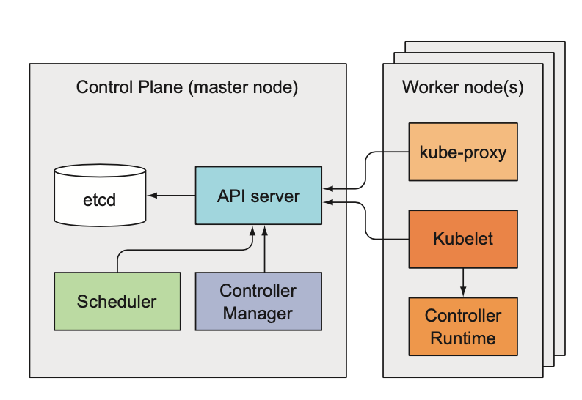
Special Architecture slides
Master Node – Control Plane
The API Server provides APIs to support lifecycle orchestration (scaling, updates, and so on) for different types of applications. It also acts as the gateway to the cluster, so the API server must be accessible by clients from outside the cluster.
ETCD is the database that stores all objects, manifests, configurations, desired state (specification) and observed state (current status). Controllers work to drive the actual state toward the desired state.
There are various controllers to drive state for nodes, replication (autoscaling), endpoints (services and pods), service accounts and tokens (namespaces). The Controller Manager is a daemon that runs the core control loops, watches the state of the cluster, and makes changes to drive status toward the desired state.
The Scheduler is responsible for the scheduling of containers across the nodes in the cluster; it takes various constraints into account, such as resource limitations or guarantees, and affinity and anti-affinity specifications.
Lucy
2003
Now

Slide 18
Special Architecture slides
Worker Node(s) – Minions
The kube-proxy consists of a DaemonSet. Every kube-proxy pod deployed on a node provides ip-table rules, essential to “pod-to-pod” communication
Container Runtime is the underlying software that is used to run containers. In our case, it happens to be Docker. The container runtime is the software that is responsible for running containers.
There kube-dns (optional) provides dns service very handy to use Kubernetes services names rather than ip adresses.
The Kubelet is the agent that runs on each node in the cluster. The agent is responsible for making sure that the containers are running on the nodes as expected. I communicates with Master to receive instructions. The kubelet takes a set of PodSpecs that are provided through various mechanisms and ensures that the containers described in those PodSpecs are running and healthy. .
Lucy
2003
Now

Slide 19
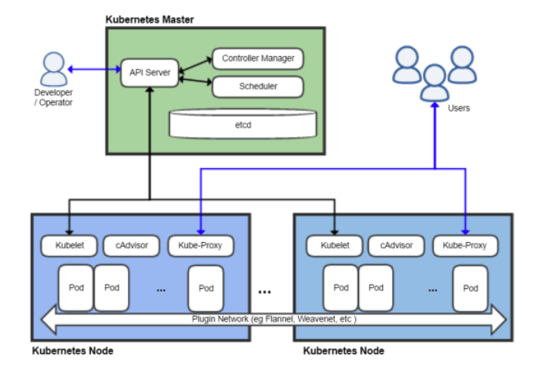
Special Architecture slides
Virtualizations and containerization played a major role in the microservices revolution
Containerized Microservices are lightweight applications written in various modern programming languages, with specific dependencies, libraries and environmental requirements.
Ensuring that the applications can run correctly by packaging them with its dependencies. Containers encapsulate microservices and their dependencies but do not run them directly. Indeed, Containers run container images.
Container image: bundles the application along with its runtime and dependencies, and a container is deployed from the container image offering an isolated executable environment for the application.
In addition to all these advantages, containerized micro-services offer
Decoupling with other services
Decoupling with hardware/system:
as long as a container runtime is installed, you can run your container image on any host os
containerized MS developped on local machine can be deployed on dev/prod servers without any modification
Lucy
2003
Now
Let's dive into it by some illustrations !

Slide 20
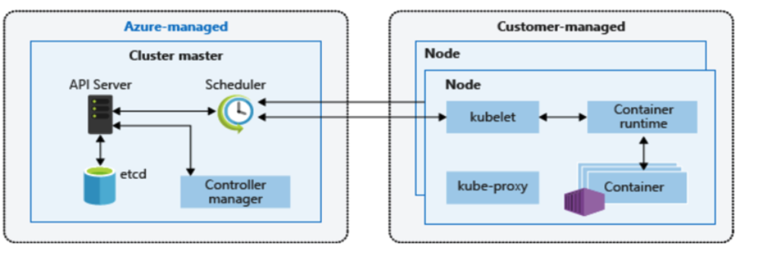
Special Architecture slides
Virtualizations and containerization played a major role in the microservices revolution
Containerized Microservices are lightweight applications written in various modern programming languages, with specific dependencies, libraries and environmental requirements.
Ensuring that the applications can run correctly by packaging them with its dependencies. Containers encapsulate microservices and their dependencies but do not run them directly. Indeed, Containers run container images.
Container image: bundles the application along with its runtime and dependencies, and a container is deployed from the container image offering an isolated executable environment for the application.
In addition to all these advantages, containerized micro-services offer
Decoupling with other services
Decoupling with hardware/system:
as long as a container runtime is installed, you can run your container image on any host os
containerized MS developped on local machine can be deployed on dev/prod servers without any modification
Lucy
2003
Now
Let's dive into it by some illustrations !

Slide 21
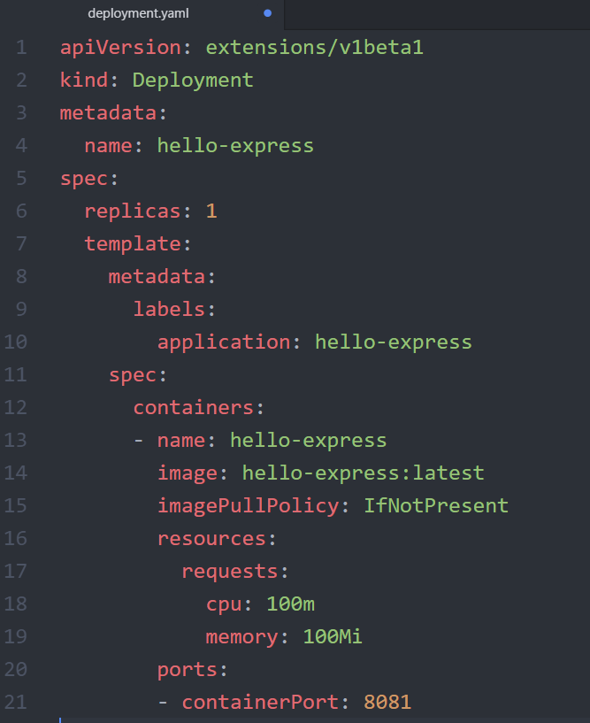
Objects
K8s objects are entities provided by Kubernetes for:
Deploying
Maintaining
And scaling
Like docker and its containers, there are two ways to create, modify, interact or delete k8s objects; either via a yaml file or via the kubernetes command line tool named kubectl.
Lucy
2003
Now

Slide 22
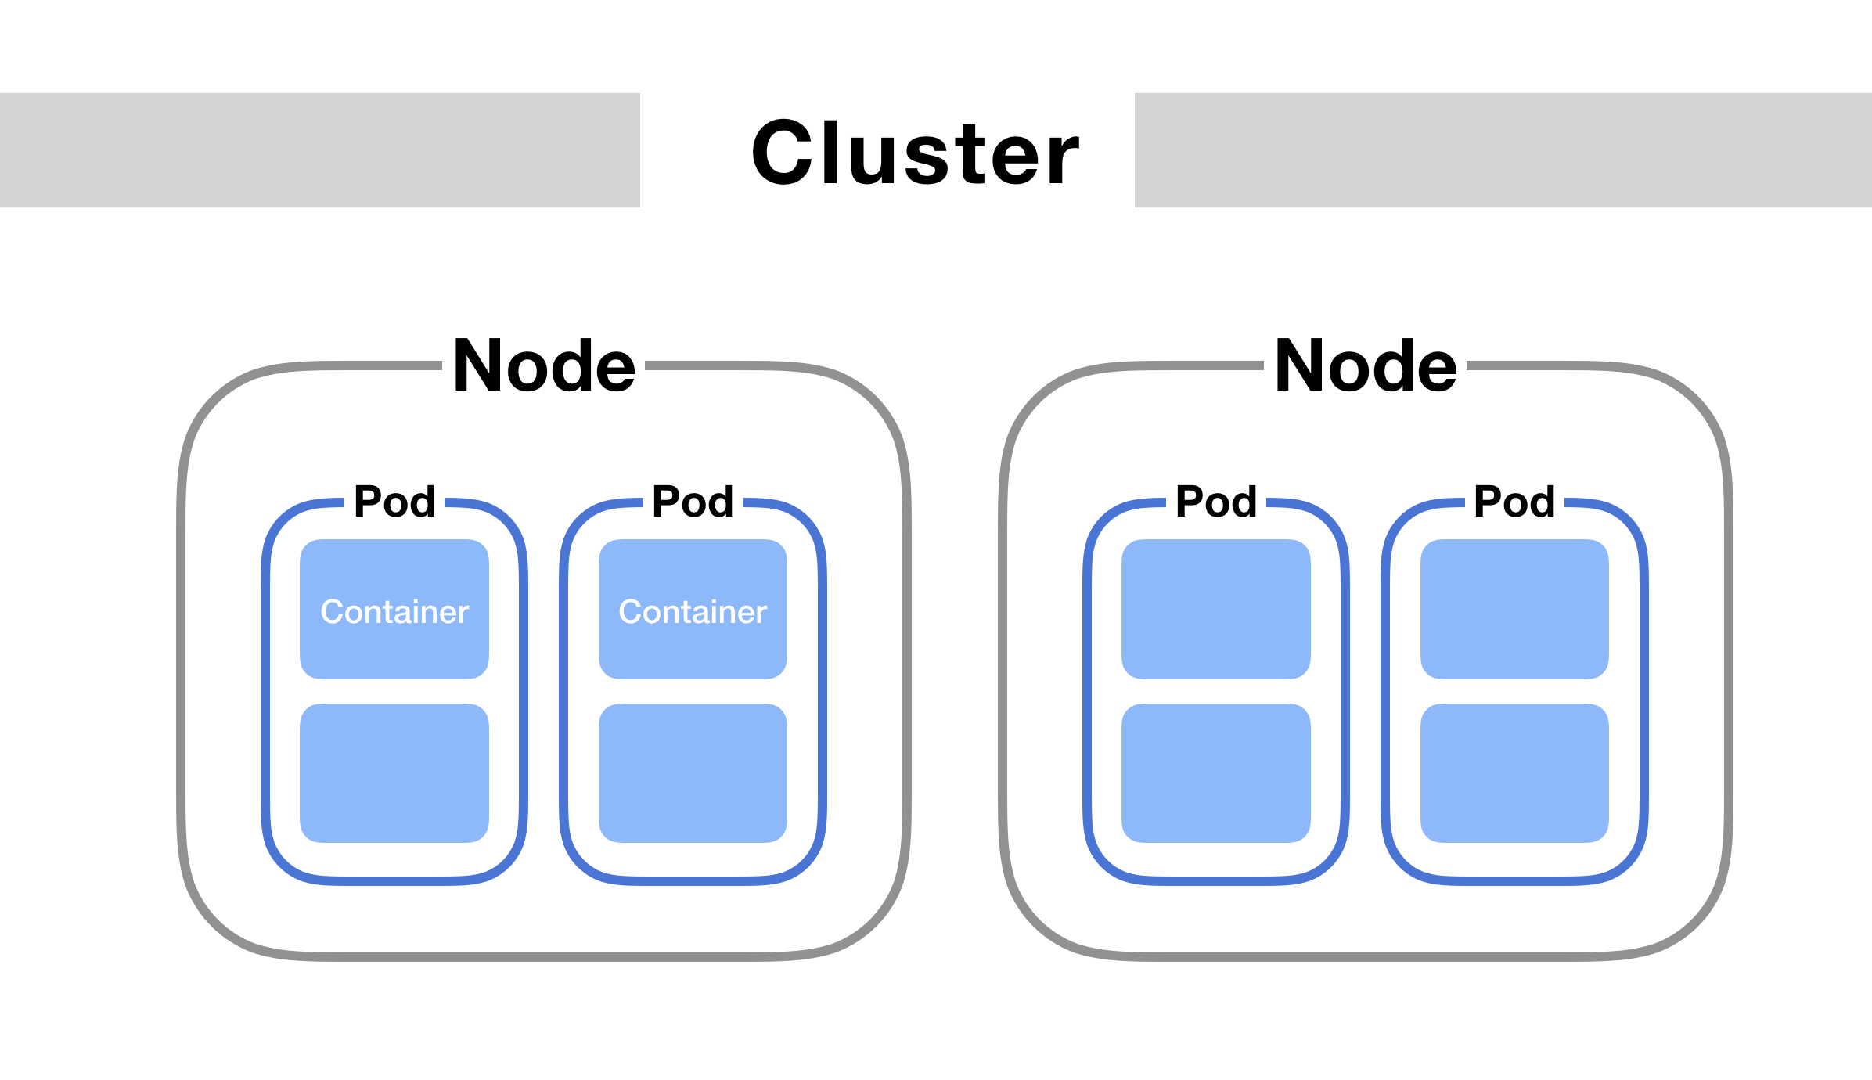
Pods
A Pod is the smallest and simplest Kubernetes object
A Pod is the container encapsulator in Kubernetes, which represents a single instance of the application.
A Pod is a logical collection of one or more containers that encapsulates
storage resources => Containers in a pod share the same storage
unique network identity => Containers in a pod share the same network - one IP address per Pod
options that govern how the container(s) should run .=> Commands, Restart Policies,…
Pods are transient => designed to be ephemeral in nature (can be destroyed at any time)
Containers in a pod share the same network, storage, same lifecycle, meaning that containers inside the same Pod
can communicate with each other directly
and will both be stopped and started at the same time.
Lucy
2003
Now
Let's dive into it by some illustrations !

Slide 23
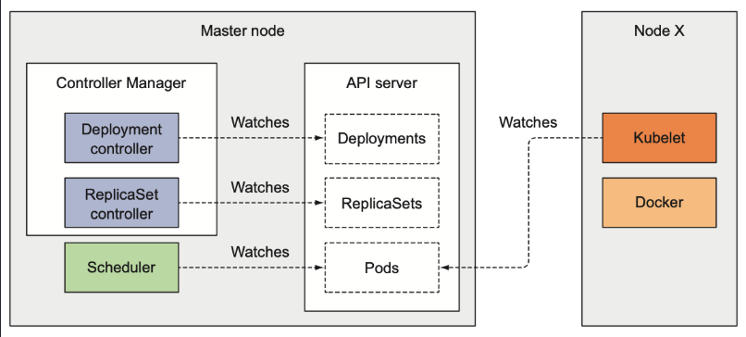
Controllers
Managing set of Pods
Workload resources are object that manage set of Pods on your behalf. These resources configure controllers that make sure the right number of the right kind of Pod are running, to match the state you specified.
Controllers ⬄ control loop WATCH state of cluster
⬄ current ≈ desired state
Controllers Vocation
Pods ephemeral in nature → cannot self-heal by themselves. Workload resources controllers manage pods to deliver
Replication / Scalability
Fault tolerance
Self healing
Seamless rollout/roll
We find 9 workload resources controllers that have the ability to manager/create pods
Lucy
2003
Now

Slide 24
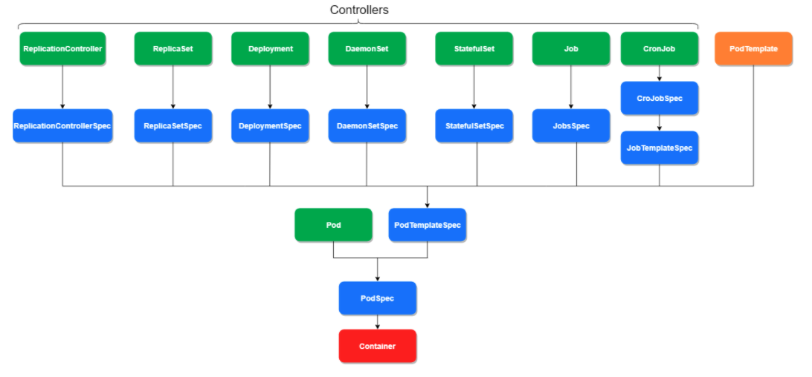
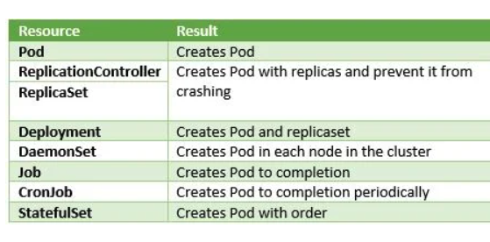
Controllers
Lucy
2003
Now
PodTemplate → metadata object containing the specs of a Pod (PodTemplateSpec).
This specification is included in each workload resource.
Controllers use PodTemplate object to make the actual Pod.

Slide 25
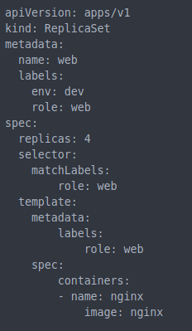
ReplicaSets
What kind of k8s object we want, here a ReplicaSet.
Metadata information for our replicaSet. A name to refer it and some labels to identify it.
Replica Set
The first spec part contains the parameters for our ReplicaSet (4 pods replicas here)
Label selector – filter criteria (set-based type) that defines the logical set of Pods managed by the controller
The second spec part is part of our pod template and define which container we want to deploy.
Pod
Template
Let's dive into it by some illustrations !

Slide 26
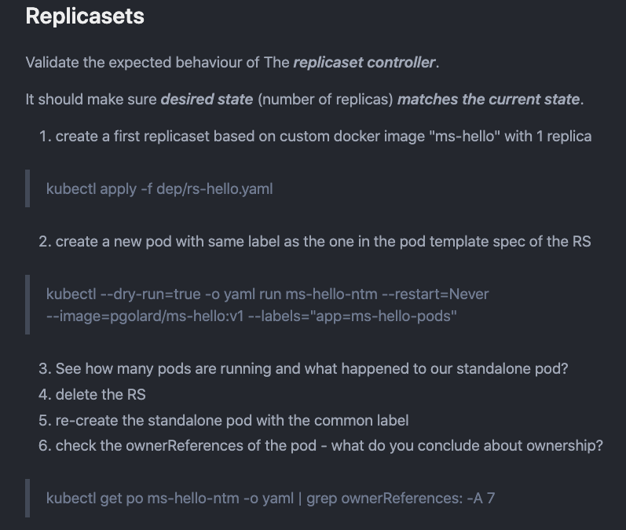
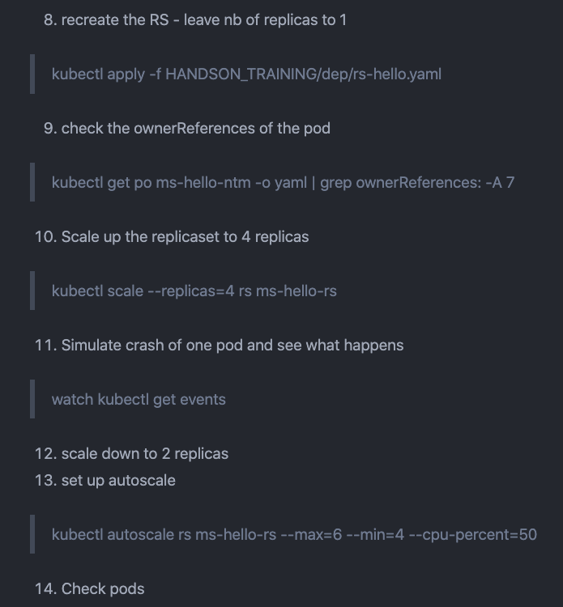
ReplicaSets
Lucy
2003
Now
Notes:
Replication-Scalability?
Self-healing?
Replication
Ownership

Slide 27
ReplicaSets
Replication-Scalability?
Self-healing?
Replication
Ownership
Lucy
2003
Now

Slide 28
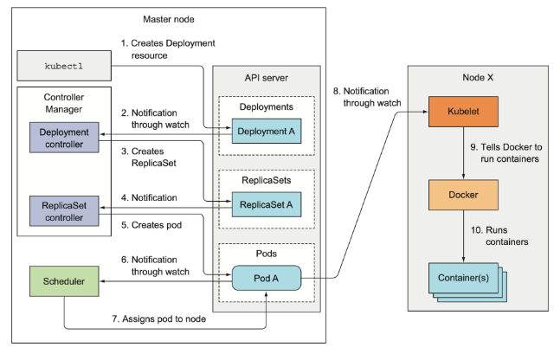
Deployments
Not possible to modify a pod template in a ReplicaSet, only option: Deleting it !
That's why a new controller has been built on top of a replicaSet: a deployment controller.
The key advantages of using a deployment :
Self-healing
scalability
replications
Rolling updates without downtime
Powerful rollout features that make rollbacks easy
Lucy
2003
Now
ReplicaSet encapsulation

Slide 29
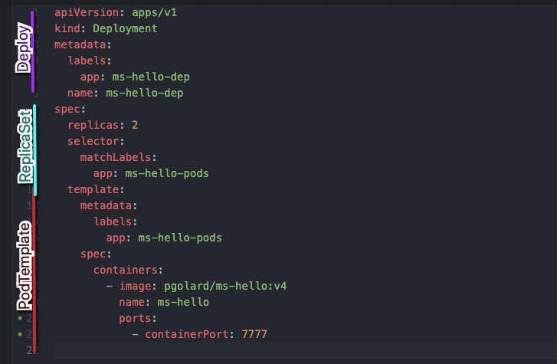
Deployments
Deployment Labels
ReplicaSet section
Selector to track pods managed by the RS
Nb of Replicas
PodTemplate section
Same Labels AS the RS selector
Spec section for the containers
Let's dive into it by some illustrations !

Slide 30
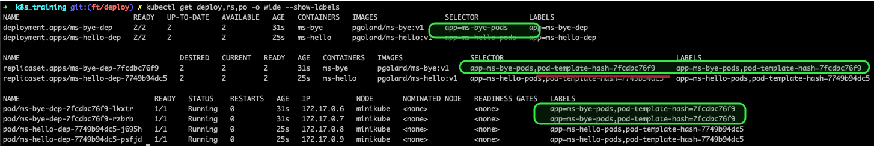
Deployments
Lucy
2003
Now
At the replica set level, we see that another label has been generated, even though it was not mentioned in our yaml files: the pod-template-hash, as the "key". We can even see the "value" of this pod-template-hash
is the suffix of the RS name
the "key"-"value" pair of the pod-template-hash, in addition to the label specified in our yaml definition (app=ms-bye-pods or app=ms-hello-pods), constitute the SELECTOR section of the replicasets.
At the pod level, we also see that the pod-template-hash "key"-"value" pair has been added to LABELS section.
This pod-template-hash is interesting: it highlights the relationship between ReplicaSet Lifecycle and pod template modifications within our deployments (detailed in deployment section).

Slide 31
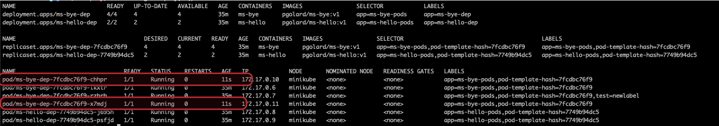
Deployments
Lucy
2003
Now
If you scale the RS or the deployment
You do not modify the PodTemplate Section
You keep the same RS

Slide 32
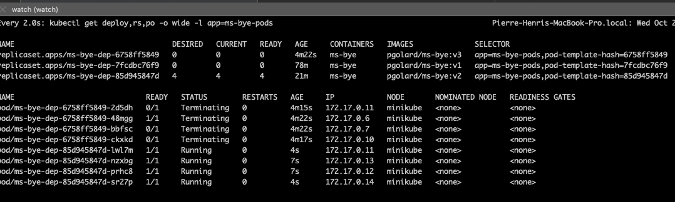
Deployments
Lucy
2003
Now
Seamless & easy rollout
Seamless & easy rollout and rollback
> kubectl set image deployment ms-bye-dep ms-bye=pgolard/ms-bye:v3 --record=true
> kubectl rollout status deployment ms-bye-dep
> kubectl rollout history deployment ms-bye-dep
> kubectl rollout history deployment ms-bye-dep --revision=3
> kubectl rollout undo deployment ms-bye-dep --to-revision=2

Slide 33
Services
Network Model
One ip per pod
Overlay
Définition svc
Diff entre port tgt port container port etv node port
Focus only on ClusterIp, NP & LB => Headless and EXT. Name nice to have for thursday
Lucy
2003
Now

Slide 34
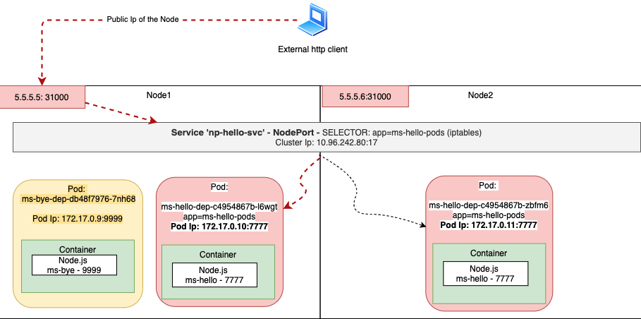
Services
NodePort
Lucy
2003
Now

Slide 35
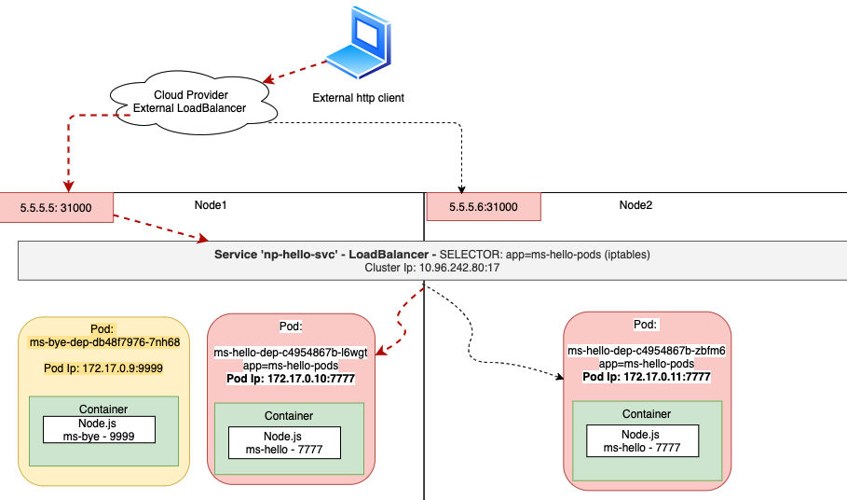
Services
Load Balancer
Lucy
2003
Now

Slide 36
Services
Headless
External name
EndPoints
Lucy
Now

Slide 37
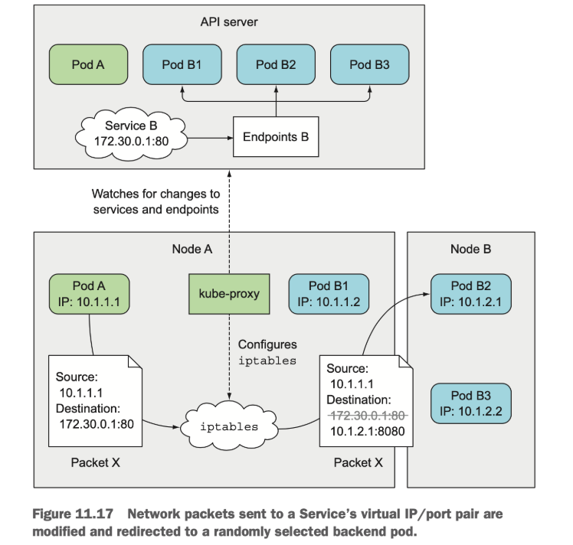
Services
Kube-proxy ip tables
Lucy
2003
Now

Slide 38
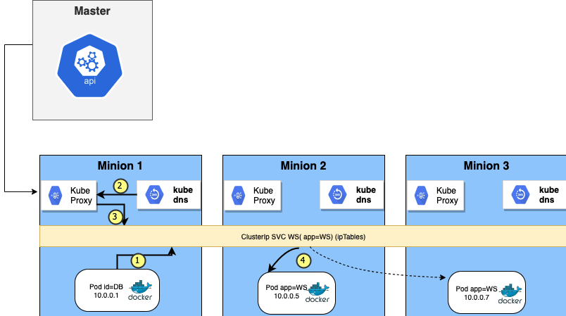
Services
Kubedns & svc discovery
Lucy

Slide 39
Volumes
How to recreate a container from the last running state => any data persistency? How can we store data outside of our container? By default of creation, containers' data storage only exists during the lifetime of its container. Therefore, for preventing any loss of data, it is crucial to use storage for storing data outside of our container. Kubernetes creates an object for handling the storage named Volumes.
prevent losing data from a pod if the container terminates
allow the next generated container to access the persisted data
A volume is seen by a pod and its containers as a directory with possibly pre-existed data that are mounted to a specific mountpath.
In most situations, it is necessary that data keeps existing even though your pod is terminated, that's possible thanks to a persistent volume.
Sometimes, you only want to pass parameters to your pod such as config files, passwords or tokens. Two k8s objects exist for doing so the ConfigMap and the secrets.
NB: A volume is also particularly useful when a container is restarted within a Pod (restartPolicy:always). In that case, any data created by your previous container would remain accessible for the next container whatever the kind of volume you use.

Slide 40
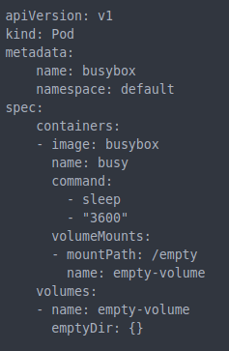
Volumes - emptyDir
EmptyDir, a non-persistent type of volume.
An empty directory is created in a container and data are written to this shared container directory.
As a transient volume, it will be destroyed when the Pod is terminated.
Lucy
2003
Now
We specify the volume we want to mount and in which directory within the Pod we want to mount it.
We create an emptyDir type of volume named empty-volume
Let's dive into it by some illustrations !

Slide 41
Volumes - emptyDir
EmptyDir, a non-persistent type of volume.
An empty directory is created in a container and data are written to this shared container directory.
As a transient volume, it will be destroyed when the Pod is terminated.
Lucy
2003
Now
We specify the volume we want to mount and in which directory within the Pod we want to mount it.
We create an emptyDir type of volume named empty-volume
Let's dive into it by some illustrations !

Slide 42
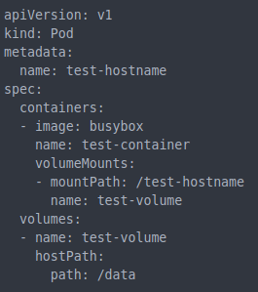
Volumes - hostPath
Hostpath, a persistent type of volume.
An existing ressource (commonly the filesystem) of the host node is mounted on the pod.
Lucy
We specify the volume we want to mount and in which directory within the Pod we want to mount it.
We create a hostpath type of volume named test-volume that will mount the host directory /data
Let's dive into it by some illustrations !

Slide 43
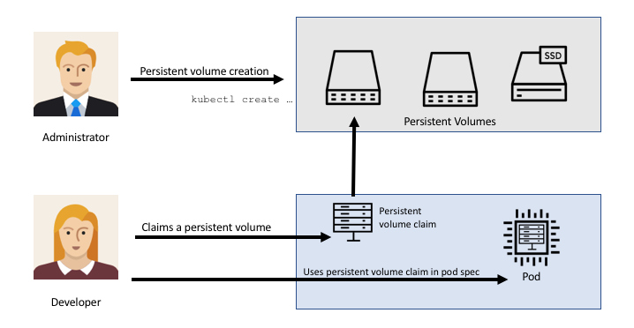
Volumes – PV and PVC
Claim a Persistent Volume (PV) via a Persistent Volume Claim (PVC)
A Persistent Volume is a volume made available within the cluster that will remain available even after containers, pods or nodes restart.
A pod can be linked to this persistent volume by setting up a Persistent Volume Claim (PVC) that defines the parameters requested for the requested volume.
The cluster will then attach a volume that fits all the parameters.

Slide 44
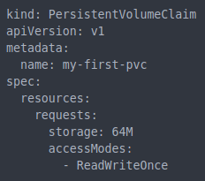
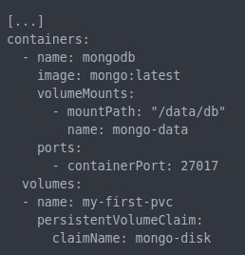
Volumes – PV and PVC
persistent_vol.yaml
Pod_template of the pod.yaml
Let's dive into it by some illustrations !

Slide 45
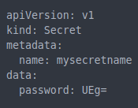
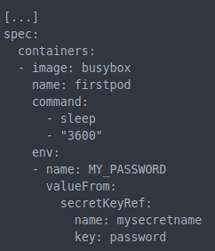
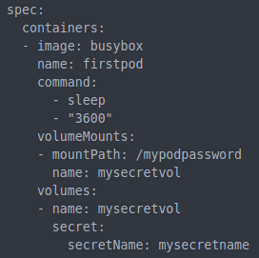
Secrets
Kubernetes Secrets let you store and manage sensitive information, such as passwords, OAuth tokens, and ssh keys. Secrets is by default base64-encoded but not encrypted. You can create as many secrets as you want that will be stored within a file that can then be used as an environment variable or as a directory like a volume. There is a limit of 1MB for the secret and as each secret is stored as an API object, a very large numbers of secrets might deplete memory of a host.
Add a volume mount
Add an environment variable
Add reference to the secret key already existing
Create a volume based on
the secret

Slide 46
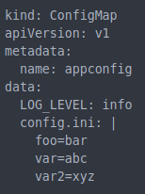
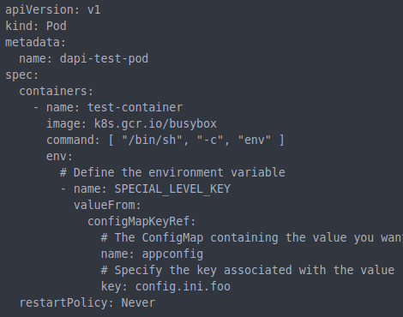
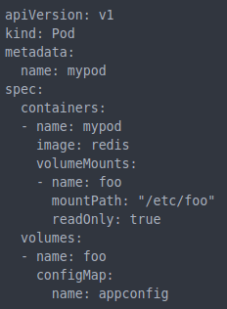
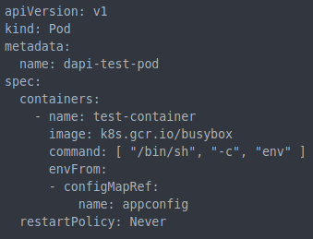
ConfigMap
A ConfigMap is an API object used to store non-confidential data in key-value pairs Pods can consume ConfigMaps as environment variables, command-line arguments, or as configuration files in a volume. A ConfigMap allows you to decouple environment-specific configuration from your container images, so that your applications are easily portable.
ConfigMap as an env in the container
ConfigMap as an env in the pod
ConfigMap as a volume

Slide 47
Carrefour use case – hands on

